Slide 1


BIG MART SALESPREDICTION

Slide 2
Content:-
Abstract
Introduction
Problem Definition & Scope
Software Requirement Specification
Proposed Work
Data Exploration
Data cleaning
Data visualization
Machine learning
Conclusion

Slide 3
Abstract
In today’s world big malls and marts record sales data of individual items for predicting future demand and inventory management .
This data Stores a large number of the item as well as individual customer data together in a data warehouse.
This data is mined for detecting frequent patterns as well as anomalies.
This data can be used for forecasting future sales volume with the help of random forest and multiple linear regression model

Slide 4
Introduction
Global malls and stores chains and the increase in the number of electronic payment customers , the competition among the rival organizations is becoming more serious day by day.
Each organization is trying to attract more customers using personalized and short time offers which makes the prediction of future volume of sales of every organization , transport service , etc.
Due to the cheap availability of computing and storage.it has become possible to use sophisticated machine learning for this purpose. In this paper , we are providing forecast for the sales data of big mart in a number of big mart stores across various location types which is based on the historical data of sales volume.

Slide 5
Problem Definition & scope
Regression is an important machine learning model for these kinds of problem. Predicting sales of a company needs time series data of that company and based on that data the model can predict the future sales of that company or product.
So , in this research project we will analyze the time series sales data of a company and will predict the sales of the company for coming quarter and for a specific product.
For this kind of project of sales predict, we will apply the linear regression and logistic regression and evaluate the result based on the training , testing and validation set of the data.

Slide 6
Software requirement specification
Matplotlib – Matplotlib helps with data analyzing , and is a numerical plotting library
Pandas – Pandas is a must for data-science . It provides fast , expressive , and flexible data structures to easily ( and intuitively) work with structured (tabular ,multidimensional , potentially heterogeneous ) and time – series data .
Numpy – It has advanced math functions and a rudimentary scientific computing package.

Slide 7
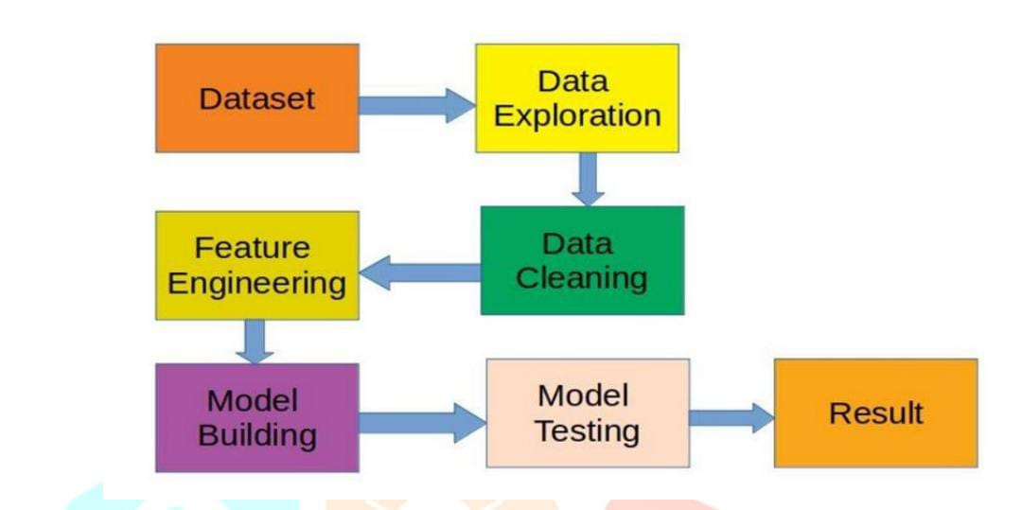
Proposed work

Slide 8
We will explore the problem in following stages:
Hypothesis Generation – understanding the problem better by brainstorming possible factors that can impact the outcome.
Data Exploration – looking at categorical and continuous feature summaries and making inference about the data.
Data Cleaning – important missing values in the data and checking for outliers.
Feature Engineering – modifying existing variables and creating for outlies.
Model Building – making predicting model on the data.
`

Slide 9
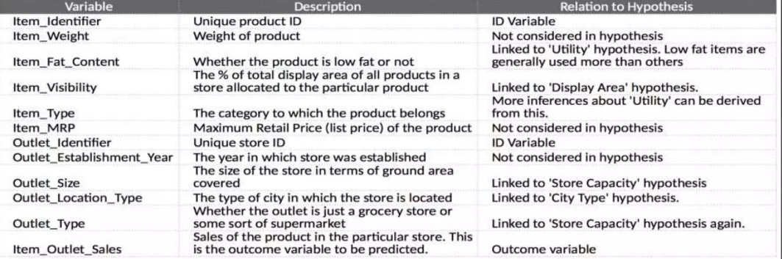
Data exploration
we’ll be performing some basic data exploration here and come up with some inferences about the data .We’ll try to figure out some irregularities and address them in the next section. He first step is to look at the data and try to look at the data and try to identify the information which we hypothesized vs the available data . A comparison between the data dictionary on the competition page and out hypotheses is shown below

Slide 10
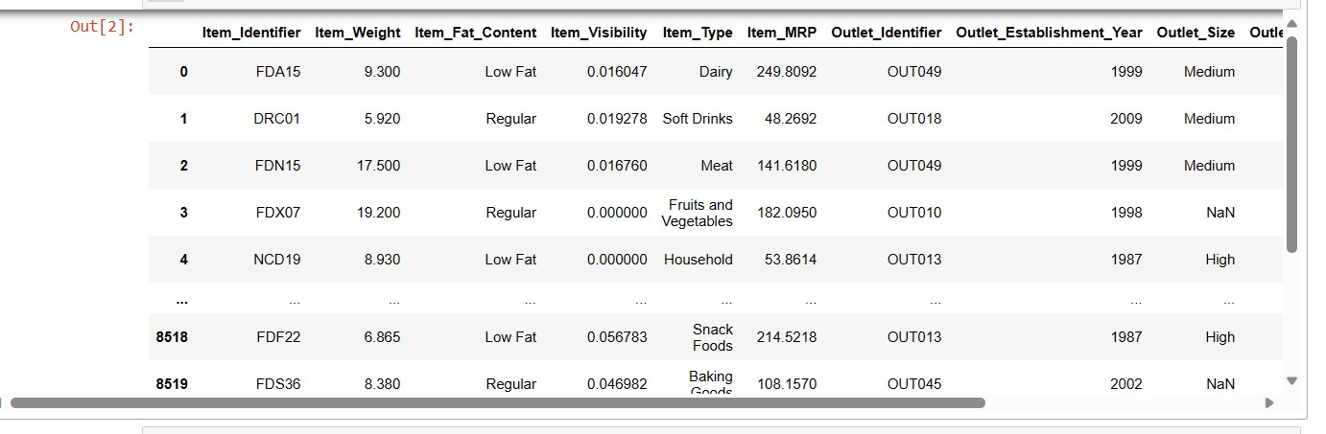
import numpy as np
import pandas as pd
import matplotlib.pyplot as plt
import seaborn as sns
import warnings
warnings.filterwarnings('ignore’)
data = pd.read_csv('Big_Mart_train.csv')
Data

Slide 11
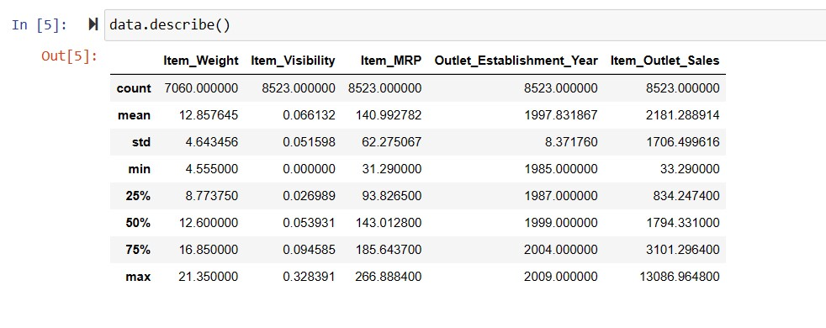
Most of the items in the train dataset present 8523 non-null values. However, there are some cases such as item_weight and outlet _size which seem to present Null values .We always have to consider if this absence of values has a significant meaning. In this case it does not since all values should have weight higher than 0 and a stores cannot exist with zero size.
Moreover, from the 12 features,5 are numeric and 7 categorical.

Slide 12
Data cleaning
This step typically involves imputing missing values and treating outliers . Though outlier removal is very important in regression techniques , advanced tree based algorithms are impervious to outliers . So I’ll leave it to you to try it out . Well focus on the imputation step here , which is a very important step.
Note: We’ll be using some Pandas library extensively here . If you’re new to pandas,
Imputing Missing Values We found variables with missing values – Item _ Weight and Outlet _ size. Lets impute the former by the average weight of the particular item . This can be done as:

Slide 13
Feature engineering
We explored some nuances in the data in the data exploration section . Lets move on to resolving them and making our data ready for analysis . We will also create some new variables using the existing ones in this section .
Step 1: Consider Combining Outlet _ Type
During exploration , we decided to consider combining the Supermarket Type 2 and Type 3 variables. But is that a good idea ? A quick way to check that could be to analyze the mean sales by type of store. If they have similar sales , then keeping them separate won’t help much.

Slide 14
Step 2 : Modify item_ Visibility We noticed that the minimum values here is 0. which makes no practical sense . Lets consider it with mean visibility of that product.
Step 3 : Create a broad category of Type of item Earlier we saw that the Item _ Type variables has 16 categories which might prove to be very useful in analysis. So it’s a good idea to combine them . One way could be to manually assign a new category to each . But there’s catch here . If you look at the Item _ Identifier , i.e. the unique ID of each item, it starts with either FD, DR or NC . If you see the categories , these look like being Food , Drinks and Non – Consumables . So I’ve used the Item _ Identifier variables to create a new column:

Slide 15
MACHINE LEARNING
ML is a branch of artificial intelligence:
Uses computing based systems to make sense out of data
Supervised Learning
For every example in the data there is always a predefined outcome
Models the relations between a set of descriptive features and a target (Fits data to a function)
2 groups of problems:
Classification
Regression
Classification
Predicts which class a given sample of data (sample of descriptive features) is part of (discrete value).
Example : Stroke prediction Analysis

Slide 16
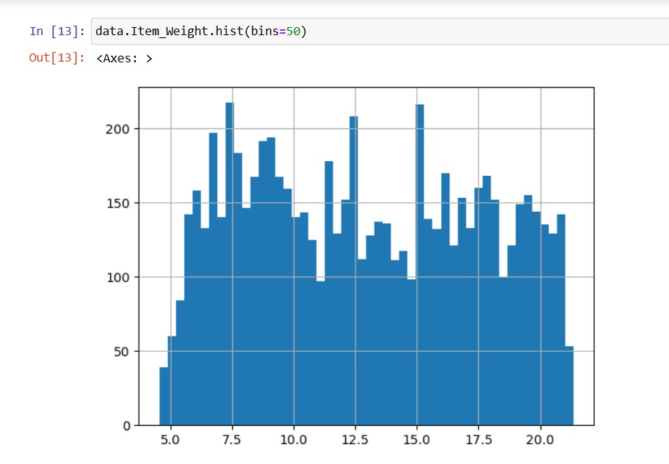
Commands for plotting graphs

Slide 17
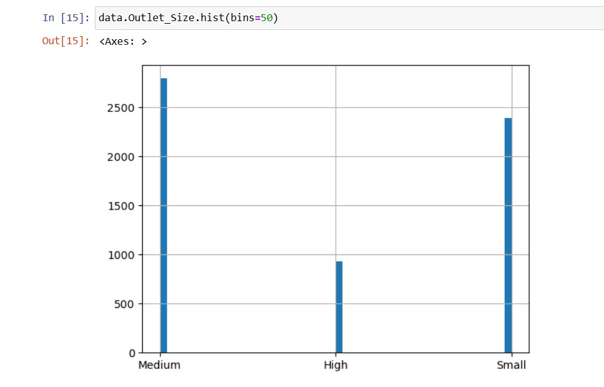
Commands for plotting graphs

Slide 18
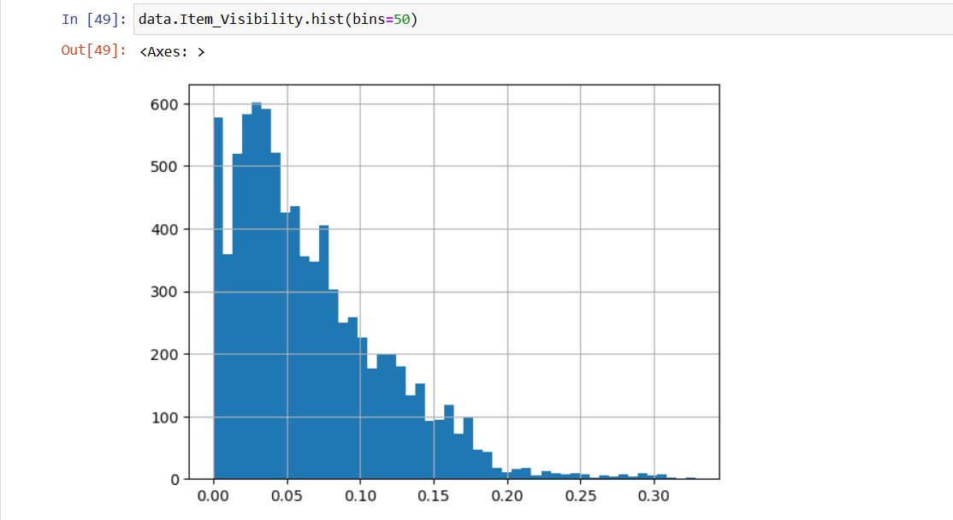
Commands for plotting graphs

Slide 19
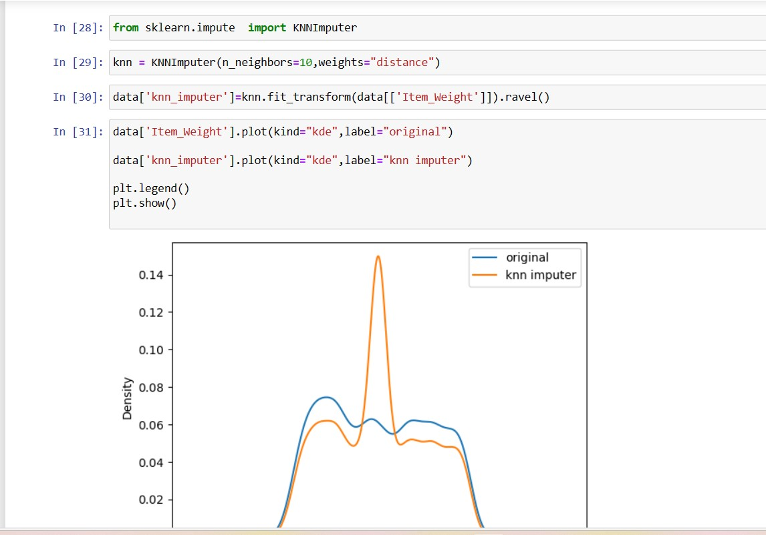
Commands for plotting graphs

Slide 20
conclusion
Most of the shopping malls / shopping centers plan to attract the customers to the store and make profit to the maximum extent by them. Once the customers enter the store they are attracted then definitely they shop more by the special offers and obtain the desired items which are available in the favorable cost and satisfy them. If the products as per the needs of the customers then it can make maximum profit the retailers can also make the changes in the operation . Objectives of the store that cause loss and efficient methods can be applied to gain more profit by observing the history of the data existing stores a clear idea of sales can be known like seasonality trend and randomness.
The advantage of forecasting is to know the number of employees should be appointed to meet the production level . sales drop is bad thing forecasting sales helps to analyze it and it can overcomes through the sales drop to remain in the competition forecast plays a vital role.

